Slide 1
World Book Day KidLit Scotland Quiz

Slide 2
Round 1 Scottish History

Slide 3
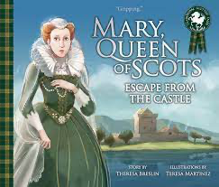
Q1: Which Scottish Queen was crowned when only a 9-month-old baby in 1542?

Slide 4
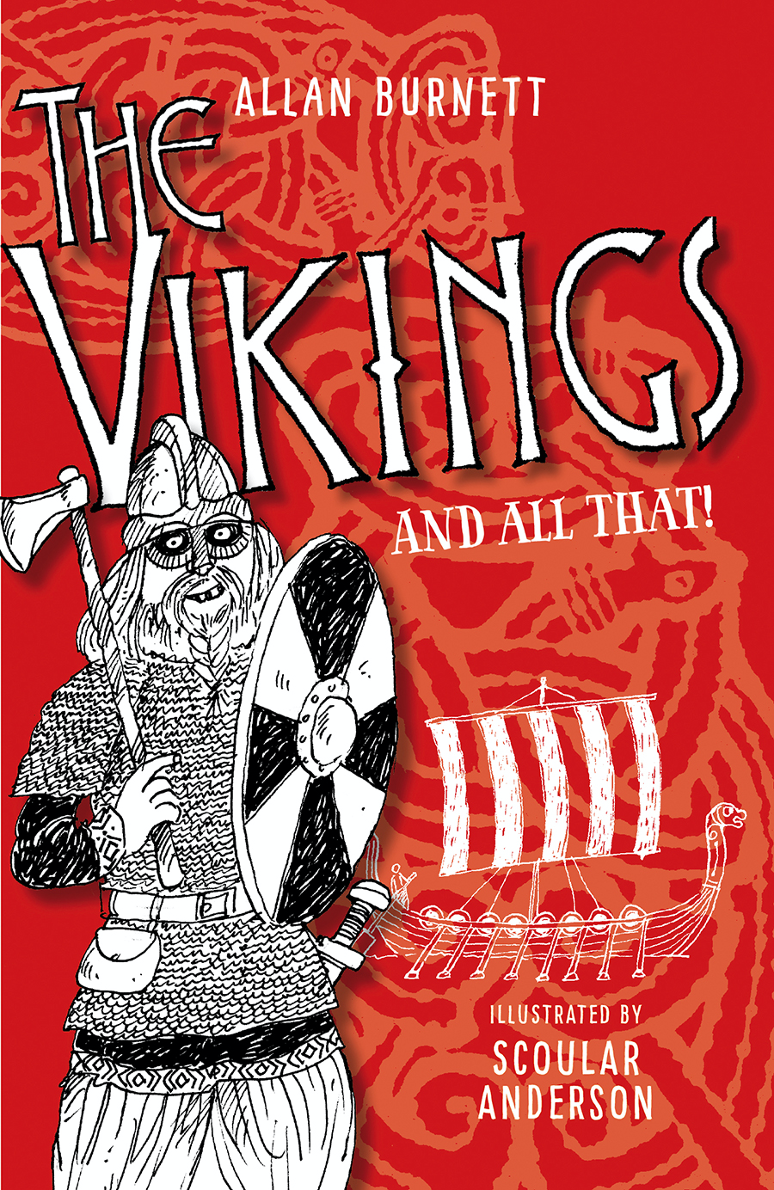
Q2: What did Vikings call their sailboats?

Slide 5
Q3: The Romans built a HUGE wall across Scotland, running from Bo’ness on the River Forth to Old Kilpatrick on the River Clyde. What do we call this wall? A) The Antonine Wall B) Hadrian’s Wall C) The Great Wall

Slide 6
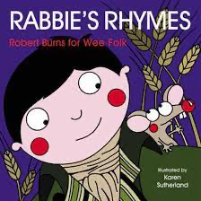
Q4: Which Scottish poet wrote ‘Auld Lang Syne’, which is sung across the world at New Year?

Slide 7
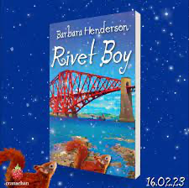
Q5: Which famous Scottish landmark took 7 years to build, needed over 50,000 tonnes of steel and features in this novel by Barbara Henderson?

Slide 8
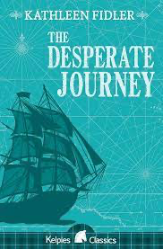
Q6: What sad historical event is described in The Desperate Journey? a) The Darien Scheme b) The Highland Clearances c) The Glencoe Massacre

Slide 9
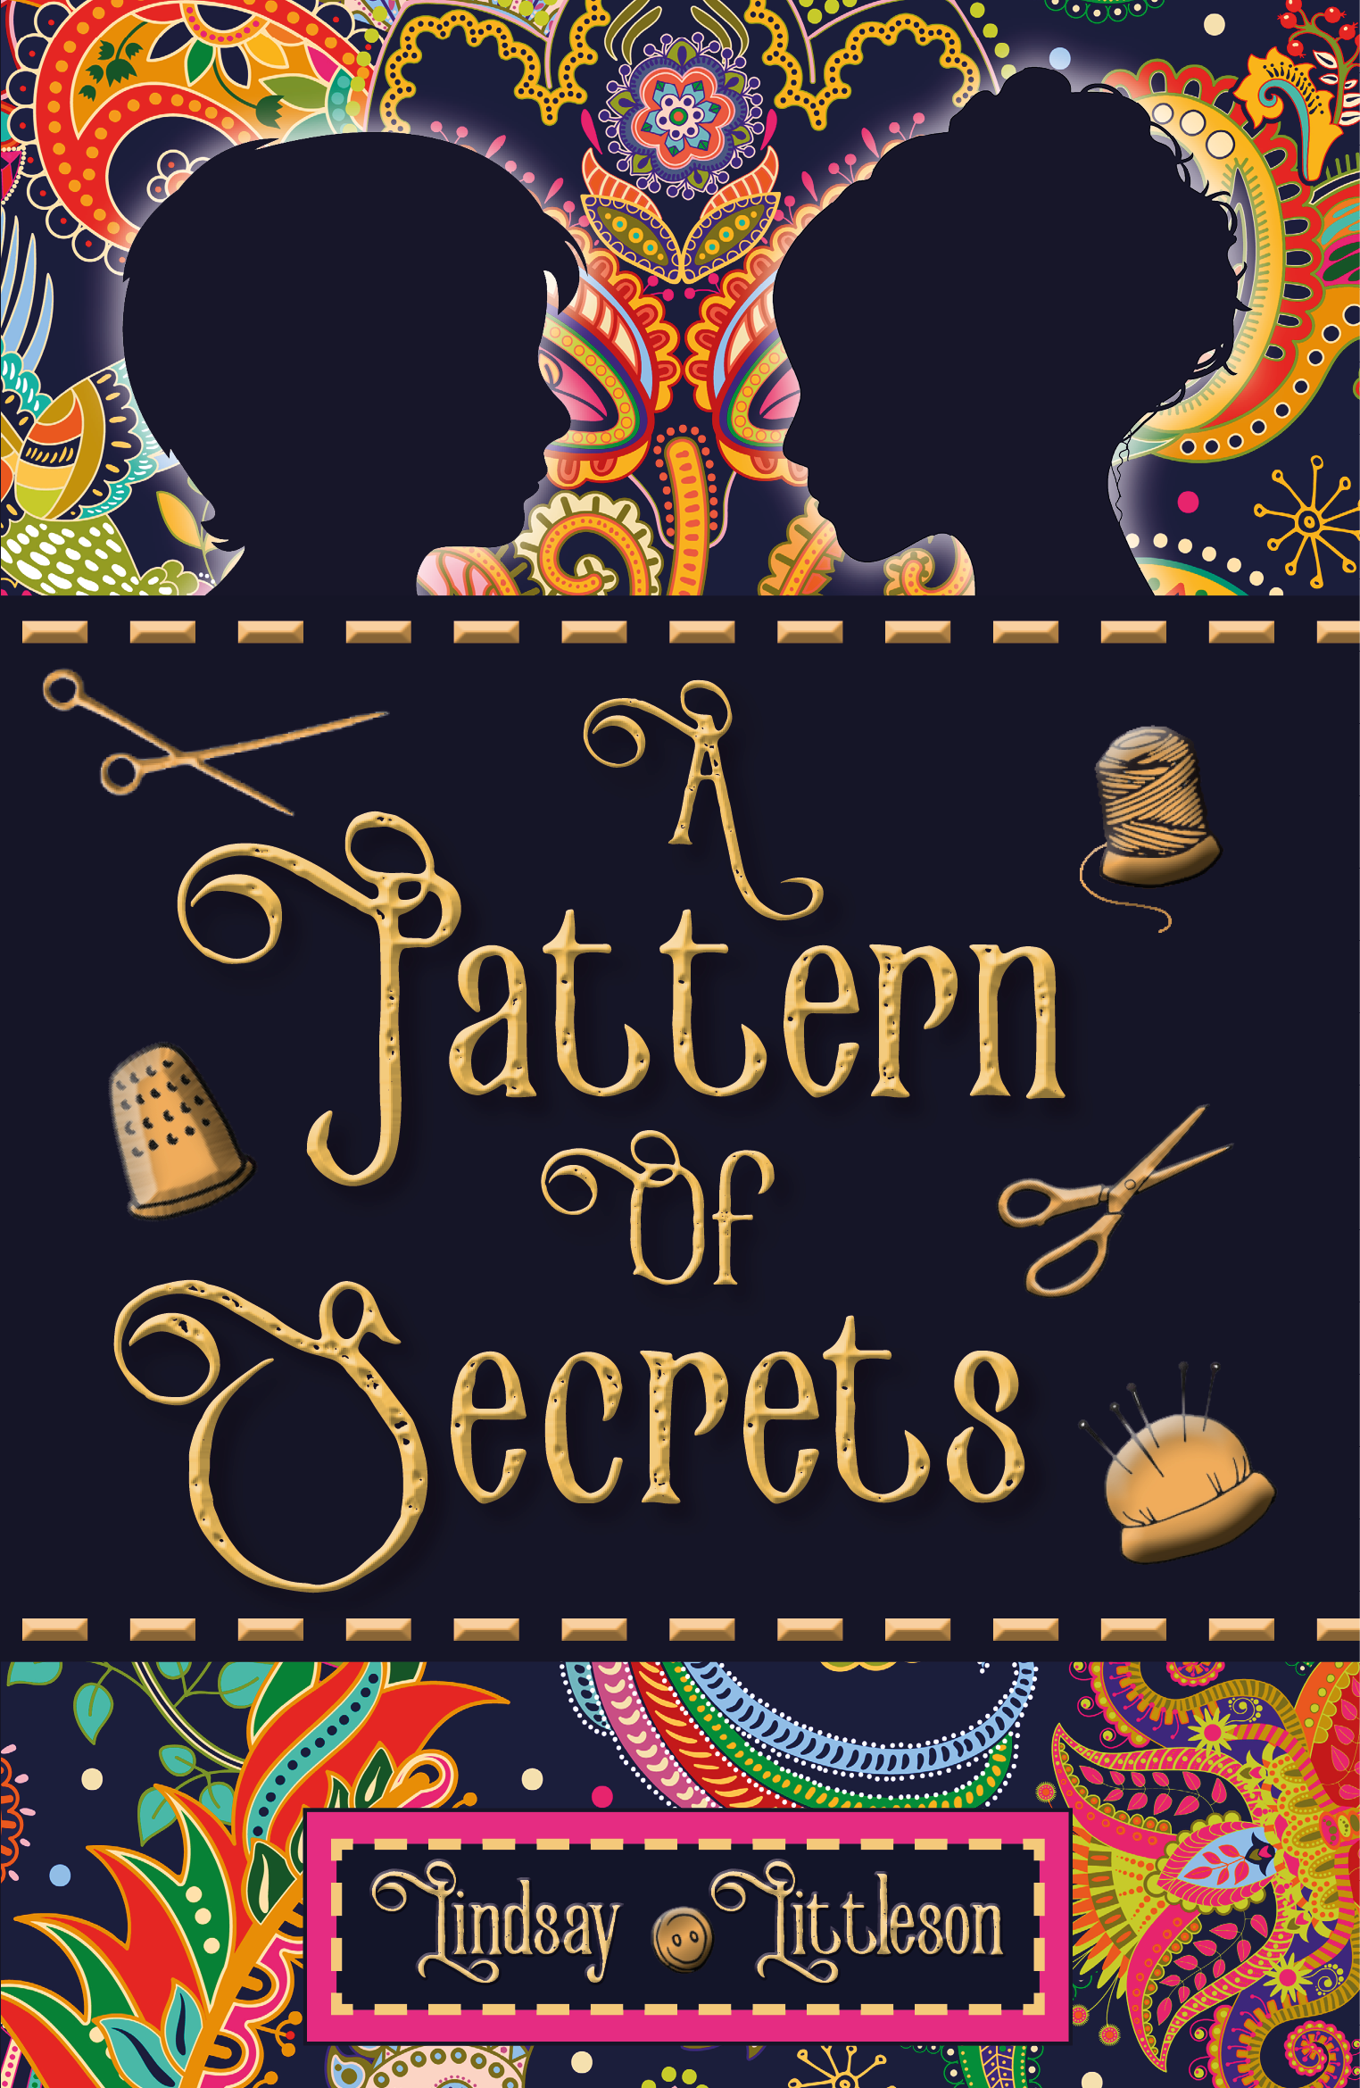
Q7: This novel is set in a Scottish town that gave its name to a famous pattern. What’s the name of the town? A) St Andrews B) Blantyre C) Paisley

Slide 10
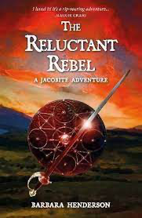
Q8: What was the name of the famous battle that was fought near Inverness in 1746? a) Hastings b) Culloden c) Bannockburn

Slide 11
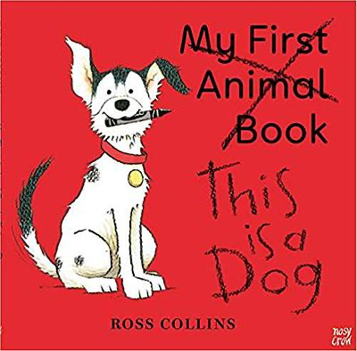
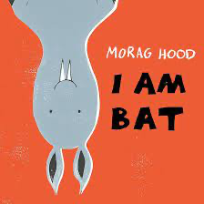
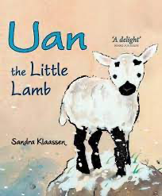
Q9: In 1996, Scottish scientists cloned the world’s first mammal, named Dolly. What kind of animal was Dolly? A) a dog b) a bat c) a sheep

Slide 12
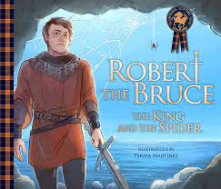
Q10: Robert the Bruce beat King Edward II at which famous battle? a) Bannockburn b) Flodden c) Largs

Slide 13
Round 2 Scottish Creatures: Real and Mythical!

Slide 14
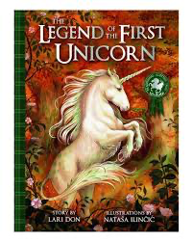
Q1: Why is the unicorn especially important in Scotland?

Slide 15
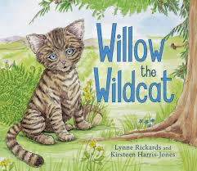
Q2: What sort of animal is Willow?

Slide 16
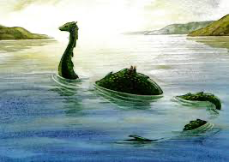
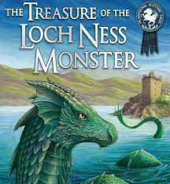
Q3: Where does this famous monster live?

Slide 17
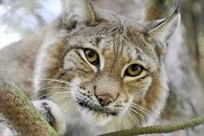
Q4: What species of big cat is pictured here?

Slide 18
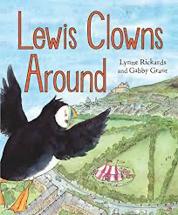
Q5: Are these birds a) penguins b)puffins c) parrots

Slide 19
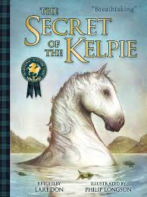
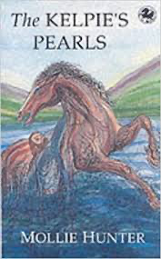
Q6: Why should you never touch a Kelpie?

Slide 20
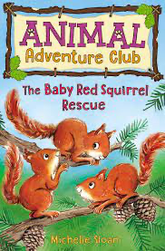
Q7: Why are red squirrels in trouble in Scotland?

Slide 21
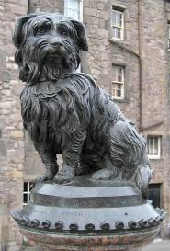
Q8: What’s the name of this famous dog from Edinburgh?

Slide 22
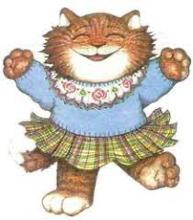
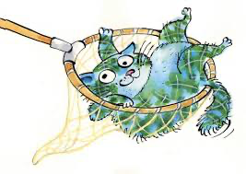
Q9: What are the names of these cute Scottish cats?

Slide 23
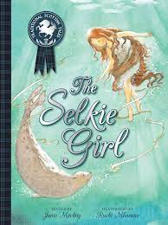
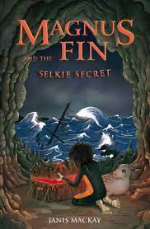
Q 10: These books feature the same mythical creature. What’s its name?

Slide 24
Round 3 Picture Books: What’s Missing?

Slide 25
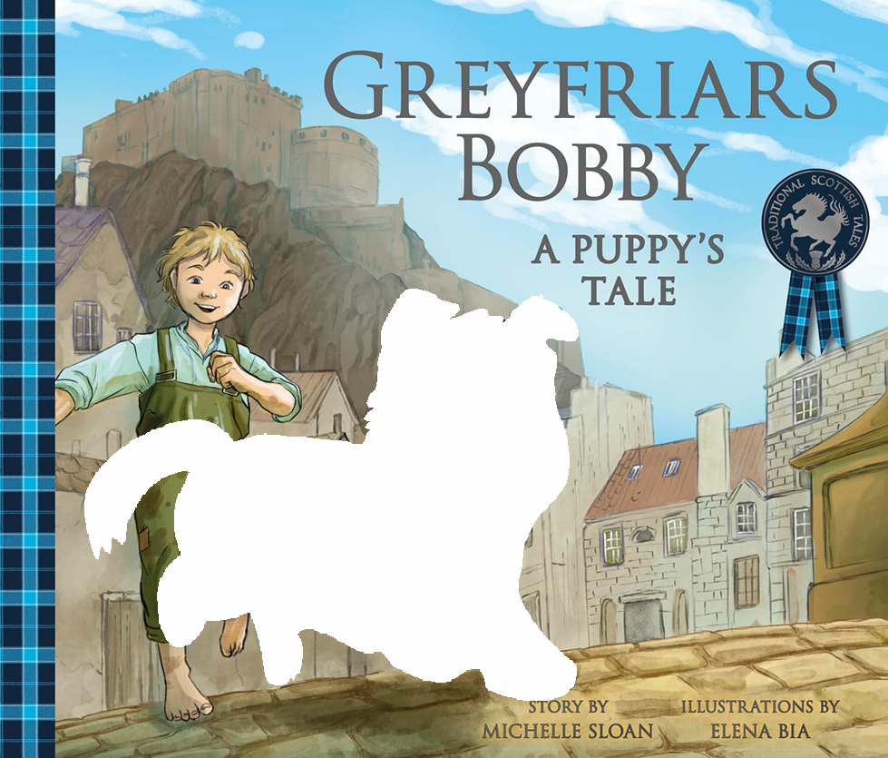
Q1: What’s missing from the cover of Greyfriar’s Bobby?

Slide 26
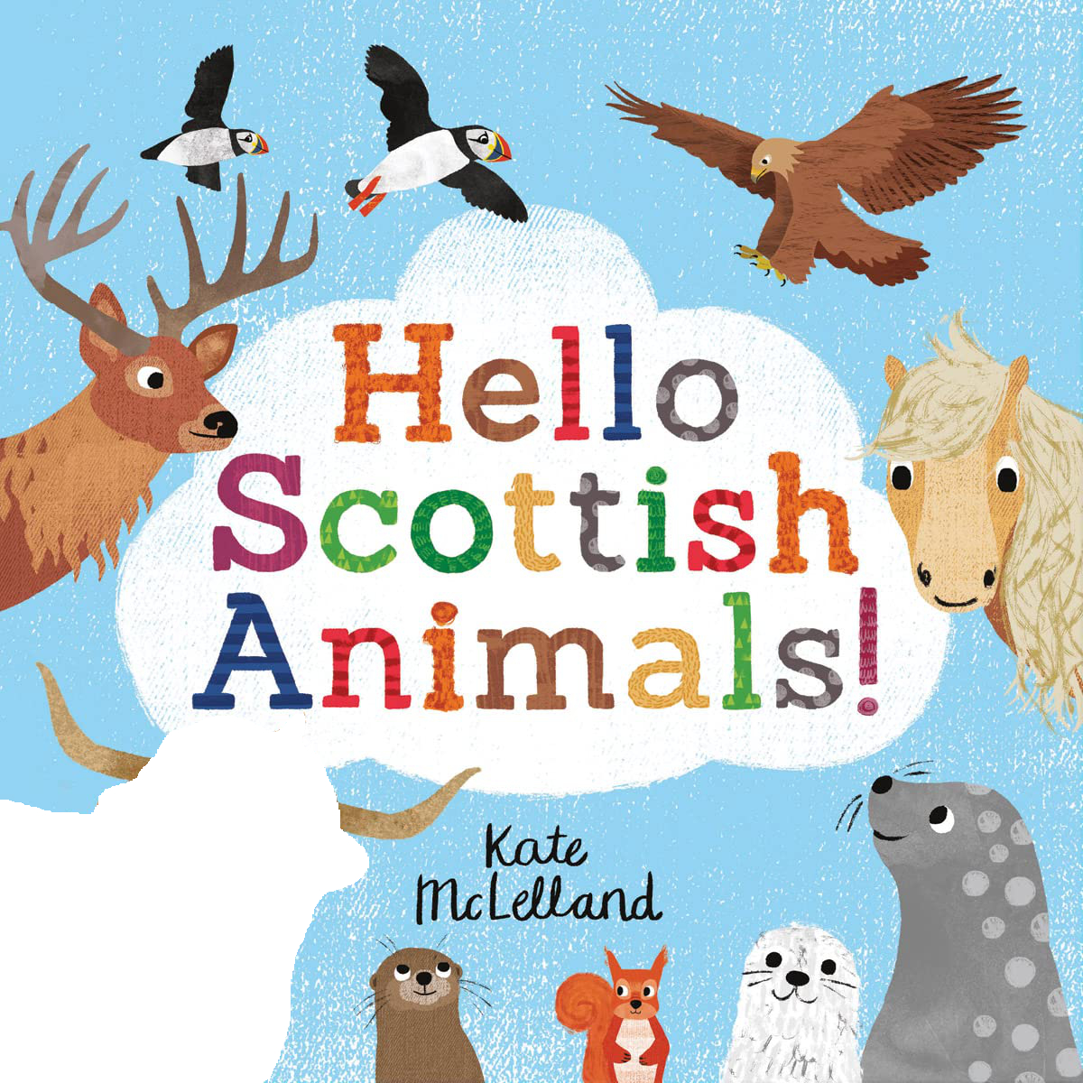
Q2: What’s missing from the cover of Hello Scottish Animals! ?

Slide 27
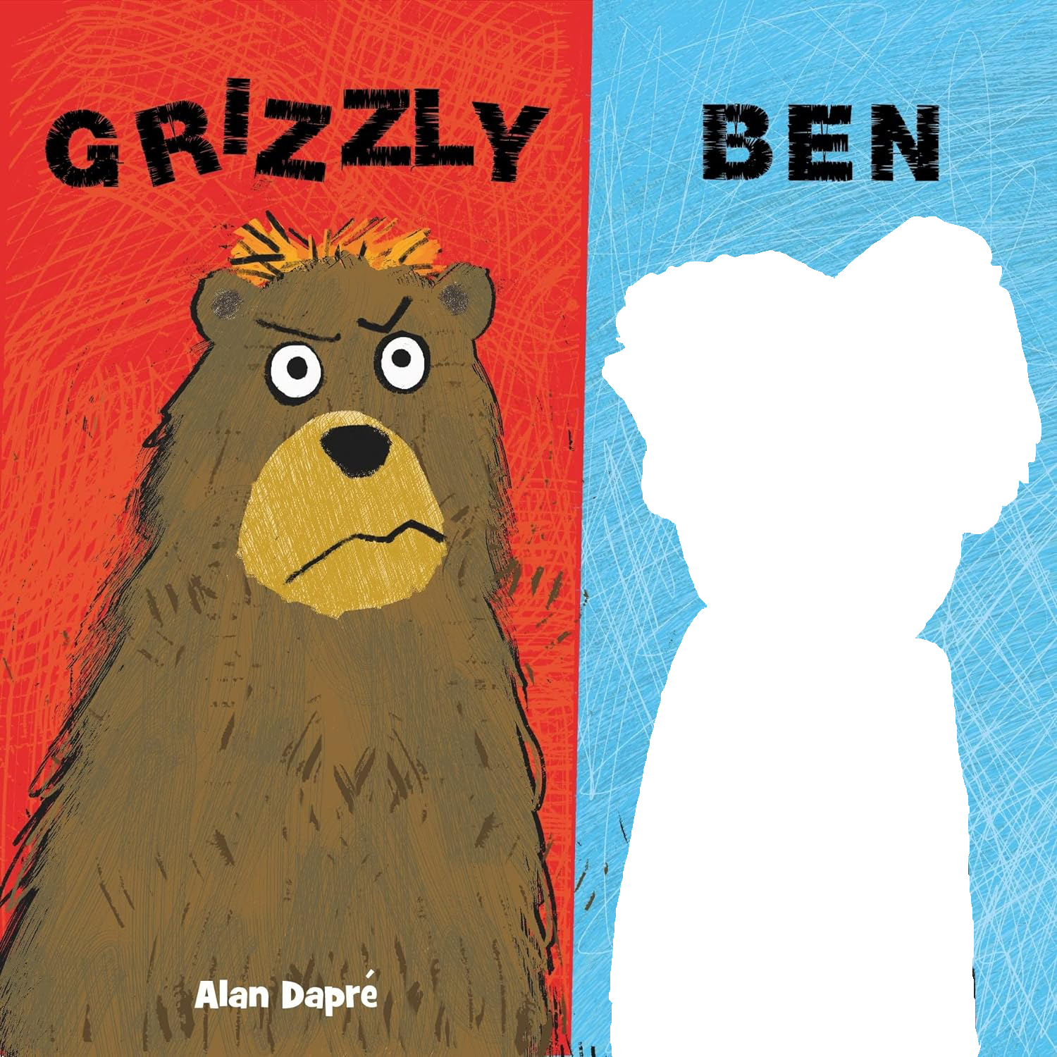
Q3: What’s missing from the cover of Grizzly Ben?

Slide 28
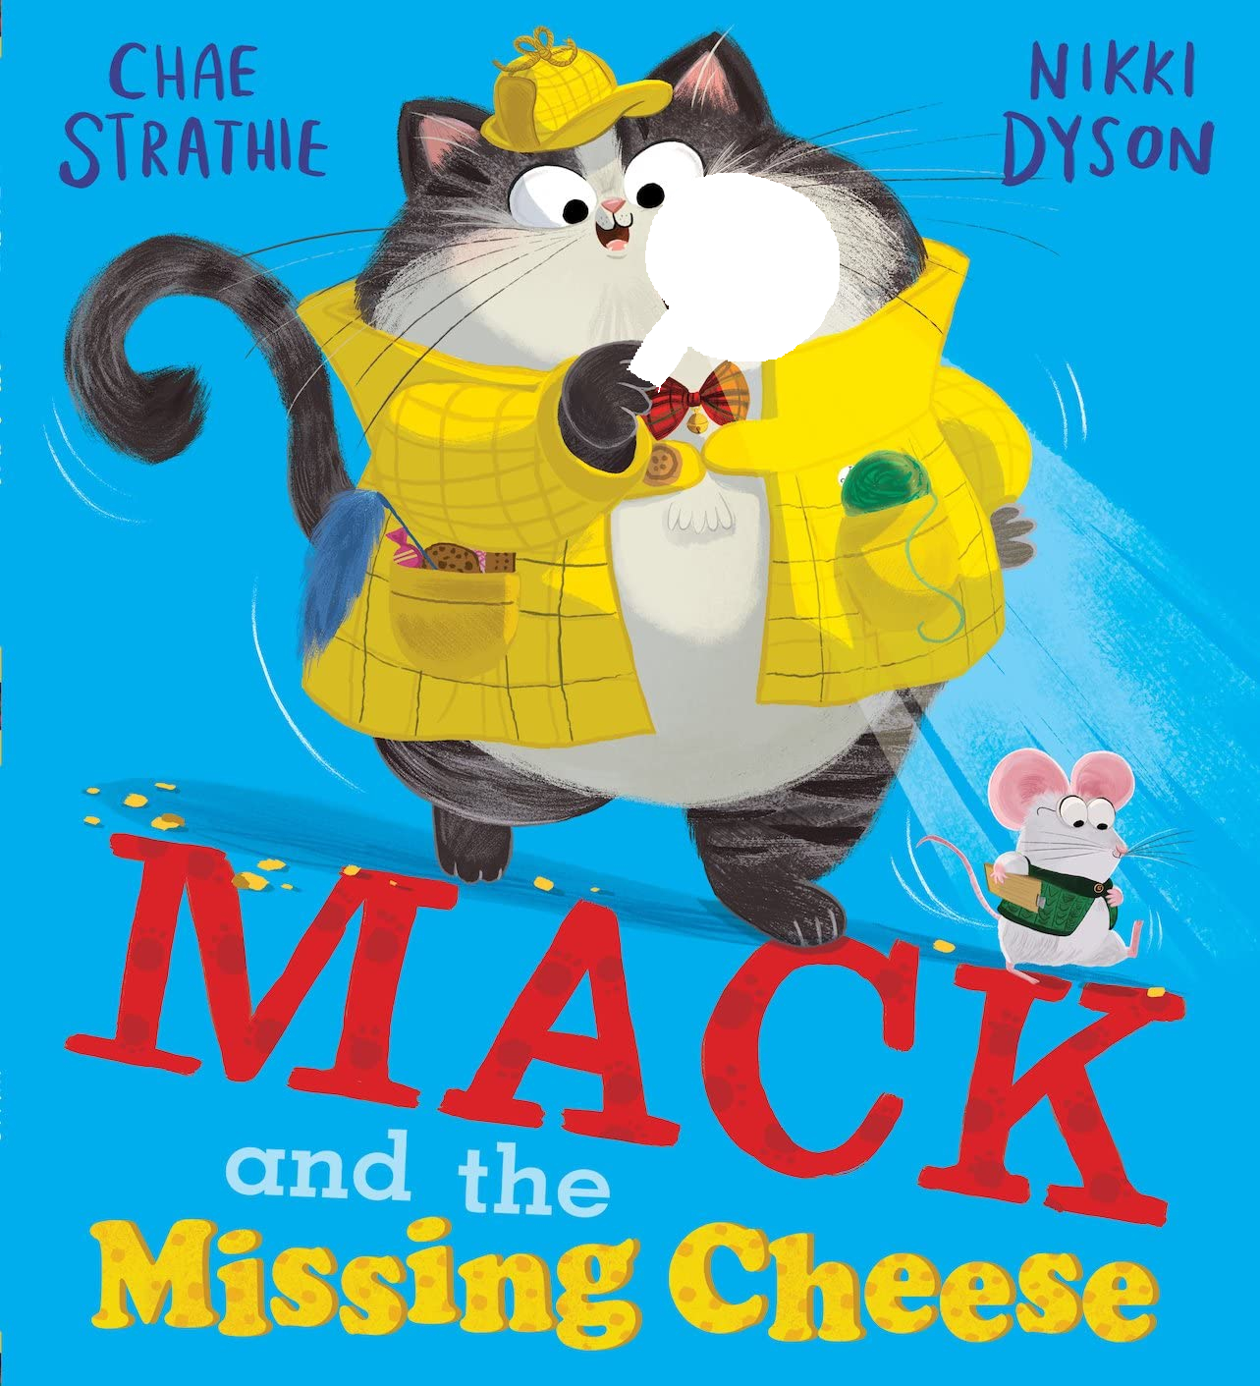
Q4: What’s missing from the cover of Mack and the Missing Cheese?

Slide 29
Q5: What’s missing from the cover of Wheesht! ?

Slide 30
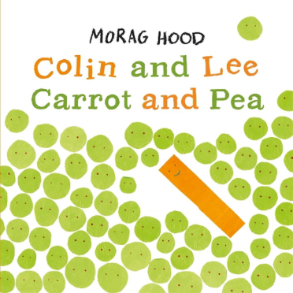
Q6: What’s missing from the cover of Colin and Lee Carrot and Pea?

Slide 31
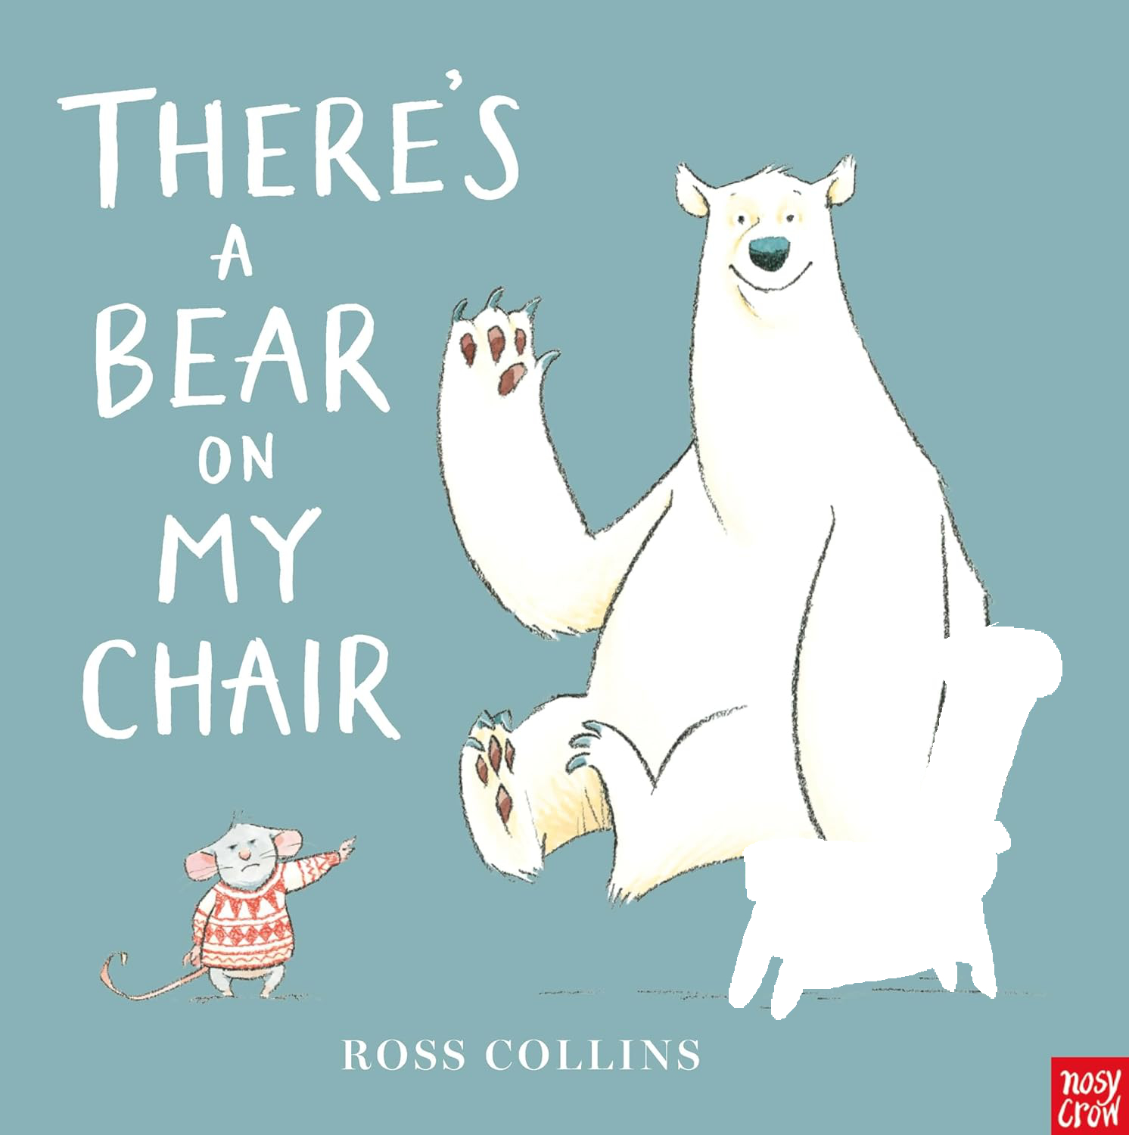
Q7: What’s missing from the cover of There’s A Bear on My Chair?

Slide 32
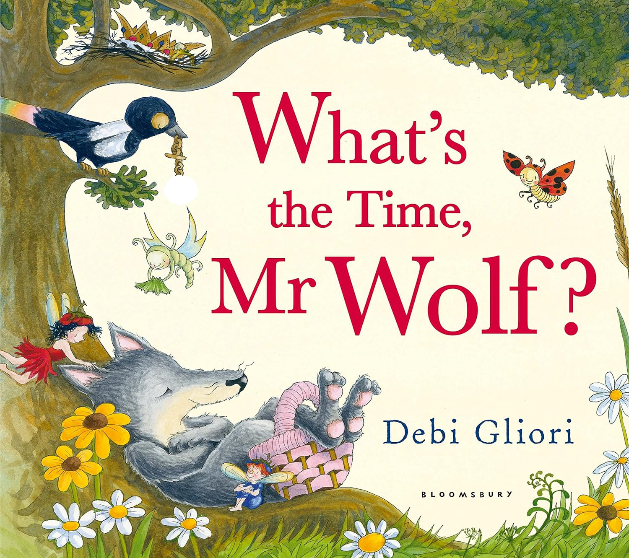
Q8: What’s missing from the cover of What’s the Time, Mr Wolf?

Slide 33
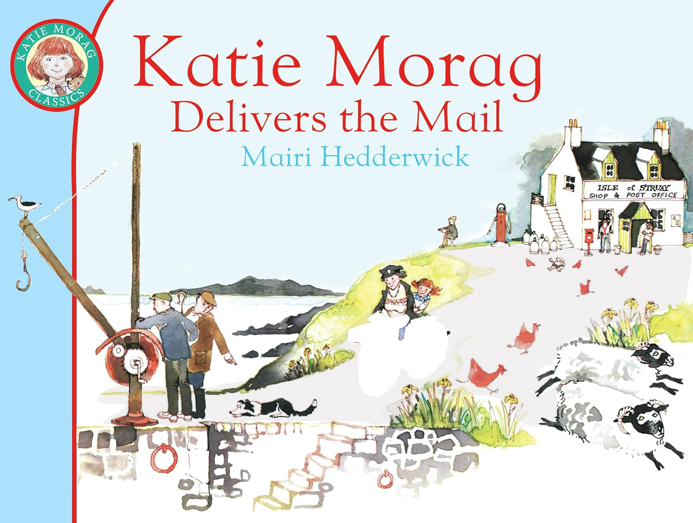
Q9: What’s missing from the cover of Katie Morag Delivers the Mail?

Slide 34
Q10: What’s missing from the cover of Caterpillar Butterfly?

Slide 35
Round 4 Titles: Missing Words

Slide 36
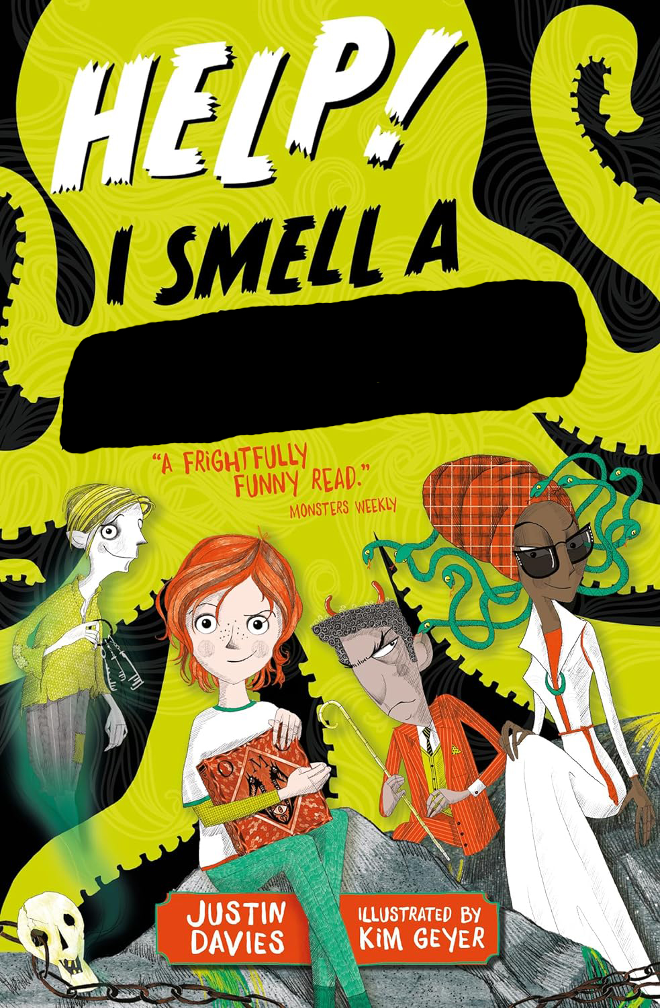
Q1: Complete the Title Help! I Smell a - - - - - - -

Slide 37
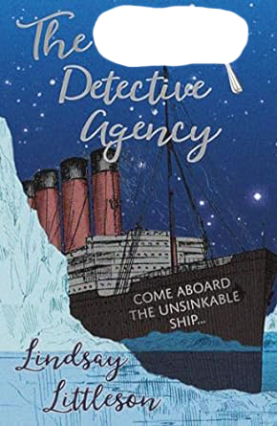
Q2: Complete the Title The - - - - - - - Detective Agency

Slide 38
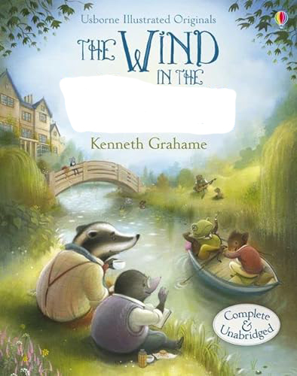
Q3: Complete the title The Wind in the _ _ _ _ _ _ _

Slide 39
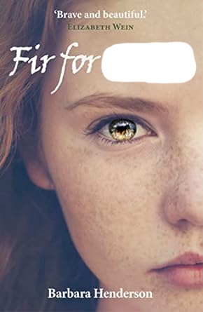
Q4: Complete the title Fir for _ _ _ _

Slide 40
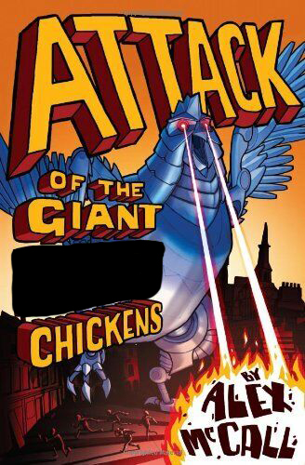
Q5: Complete the title Attack of the Giant _ _ _ _ _ Chickens

Slide 41
Q6: Complete the title The Fox Girl and the White _ _ _ _ _ _ _

Slide 42
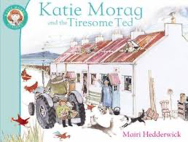
Q7: Complete the title: Katie Morag and the Tiresome _ _ _

Slide 43
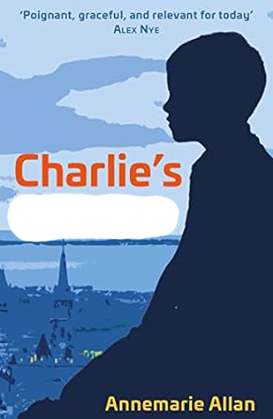
Q8: Complete the title Charlie’s _ _ _ _ _ _ _

Slide 44
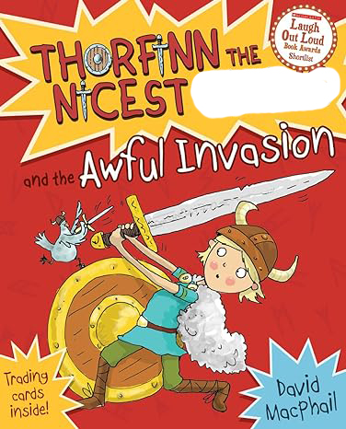
Q9: Complete the title Thorfinn the Nicest _ _ _ _ _ _ and the Awful Invasion

Slide 45
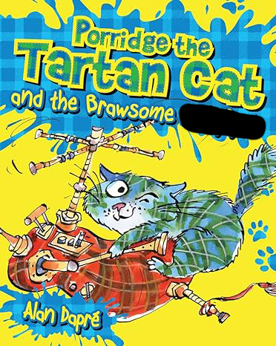
Q10: Complete the title Porridge the Tartan Cat and the Brawsome _ _ _ _ _ _ _ _

Slide 46
Round 5 Julia Donaldson

Slide 47
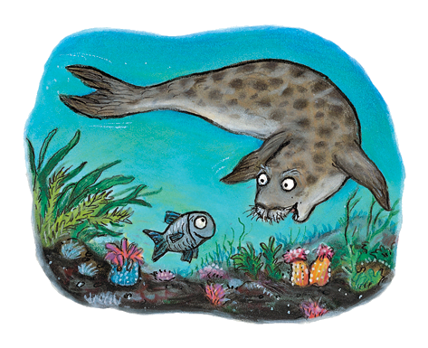
Q1: What’s the name of this cute little fish?

Slide 48
Q2: Who is the hero of this book by Julia Donaldson?

Slide 49
Q3: What does Tabby McTat do (badly) to try and help his busker friend, Fred?

Slide 50
Q4: What word is missing from the Fairy Godmother’s spell? “By changing her colour and changing her _ _ _ _ _, the princess may try seven times to escape.”

Slide 51
Q5: What’s the name of the illustrator of this famous story?

Slide 52
Q6: When the old lady complains her house is too small, what does the wise old man tell her to do?

Slide 53
Q7: Which famous person helps Stick Man to get back to the family home?

Slide 54
Q8: What’s the 2 word title of this Stone Age set book by Julia Donaldson?

Slide 55
Q9: Name 3 of the things Zog has to learn during his 5 years at dragon school!

Slide 56
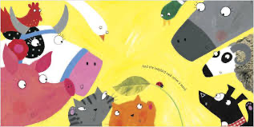
Q10: What’s the title of this funny story by Julia Donaldson?

Slide 57
Round 6 True or False?

Slide 58
Q1: True or False? Talking History, by Joan Lennon and Joan Haig, is a book about famous speeches in history.

Slide 59
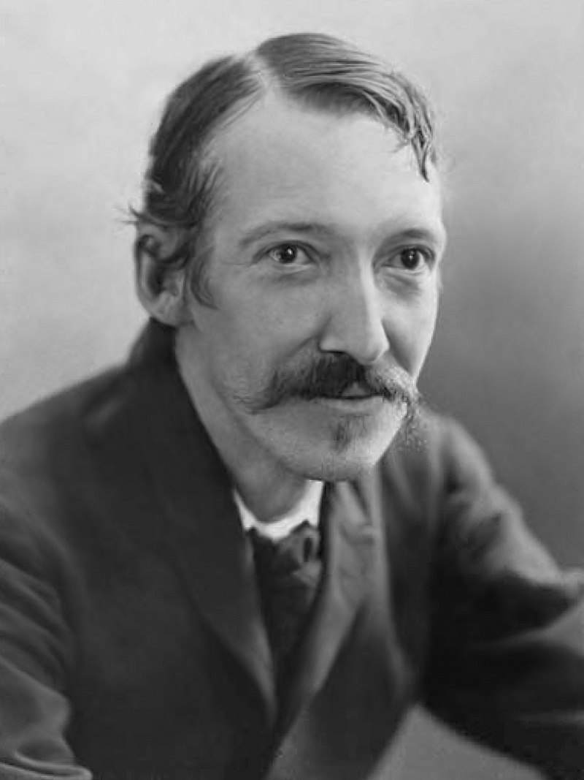
Q2: True or False? Scottish Writer Robert Louis Stevenson wrote the famous book, Treasure Island.

Slide 60
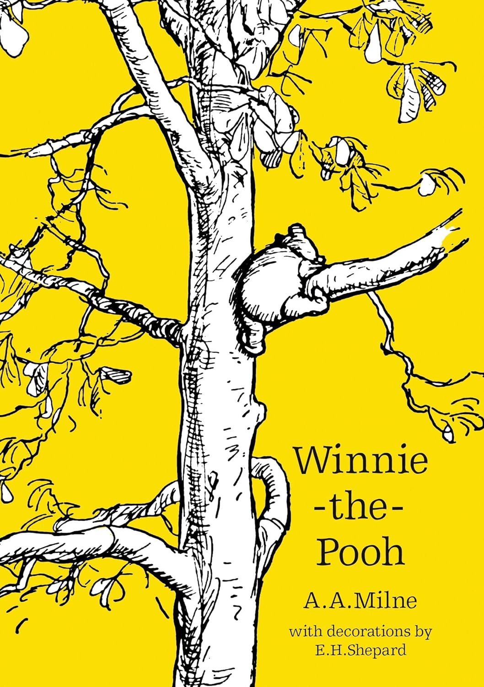
Q3: True or False? The Winnie the Pooh stories were written by a Scottish author.

Slide 61
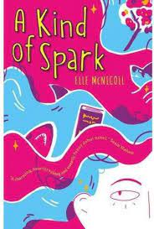
Q4: True or False? A Kind of Spark by Elle McNicoll was made into a TV Drama.

Slide 62
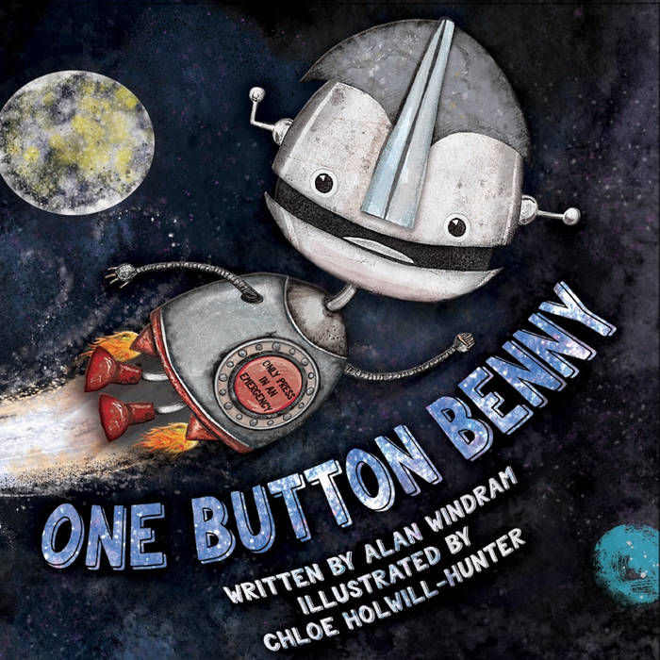
Q5: True or False? One Button Benny is illustrated by Alan Windram.

Slide 63
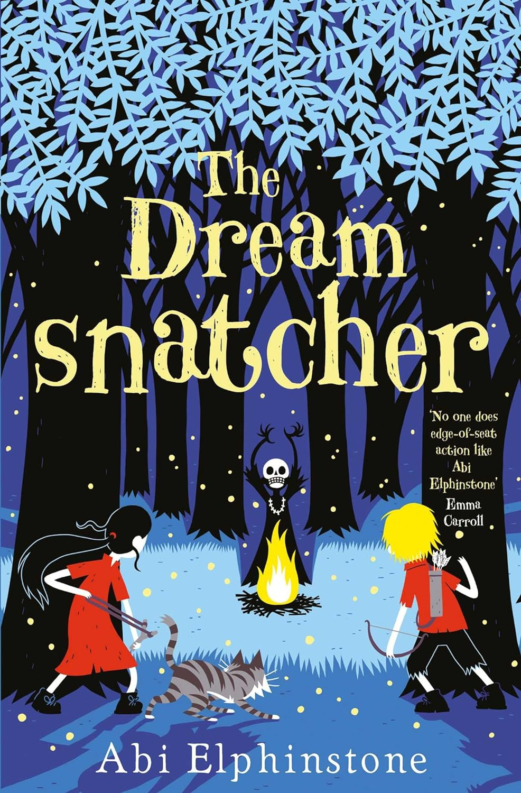
Q6: True or False? The NEXT book in this series by Scotland-based Abi Elphinstone is called The Shadow Creeper.

Slide 64
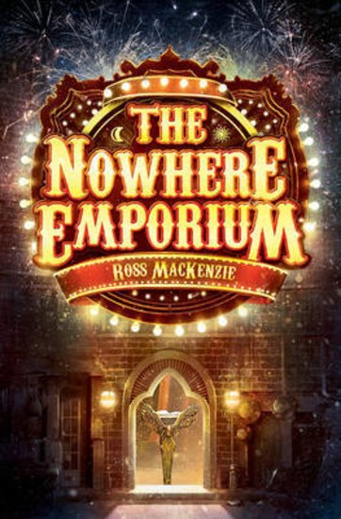
Q7: True or False? This book by a Scottish author won the Blue Peter Book Award.

Slide 65
Q8: True or False? Porridge the Tartan Cat turns tartan by falling into a paint pot of tartan paint.

Slide 66
Q9: True or False? Callum and the Mountain is written by a famous TV celebrity.

Slide 67
Q10: True or False? The God of all Small Boys is a World War 1 story set in America.

Slide 68
Round 7 Book Settings

Slide 69
Q1: In which Scottish city is Divided City by Theresa Breslin set?

Slide 70
Q2: In Keep Dancing, Lizzie Chu by Maisie Chan the characters go on a road trip from Glasgow to a town in England, famous for its ballroom. What’s the town’s name?

Slide 71
Q3: What’s the name of the fictional island where Katie Morag lives?

Slide 72
Q4: Name the village near Hogwarts School which Harry Potter is allowed to visit in 3rd Year.

Slide 73
Q5: In this novel by Barbara Henderson, what sort of building is Caerlaverock?

Slide 74
Q6: What’s the name of the fictional city where Orphans of The Tide is set?

Slide 75
Q7: What’s the name of the magical land where Peter Pan and the Lost Boys live?

Slide 76
Q8: Tiger Skin Rug by Joan Haig is set in Scotland and which other country?

Slide 77
Q9: What’s the missing word?

Slide 78
Q10:Look carefully at the cover of this atlas. Who is the illustrator?

Slide 79
Round 8 Books in Scots

Slide 80
Q1: What does “Haud yer wheesht” mean?

Slide 81
Q2: What’s the original title of this classic picture book by Judith Kerr?

Slide 82
Q3: What sort of bird does the wee lassie swallow first?

Slide 83
Q4: What does “Coorie Doon” mean?

Slide 84
Q5: What sort of animal is the Wee Mowdie?

Slide 85
Q6:Who drew the hoolet on the cover of this picture book??

Slide 86
Q7:Finish the title of this well-known poem by JK Annand Mince and …………….

Slide 87
Q8: This picture book in Scots retells a poem by which famous poet?

Slide 88
Q9: What’s the original title of this funny book by Roald Dahl?

Slide 89
Q10: Which granny CAN you shove off a bus?

