Slide 1
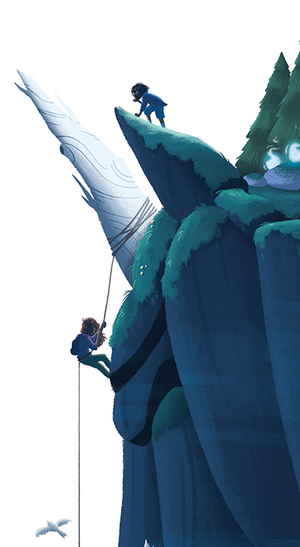
Guardians of the Wild Unicorns
By Lindsay Littleson

Slide 2
Week 1
Guardians of the Wild Unicorns by Lindsay Littleson
Prior Knowledge/ Prediction
L.I - Create a new front cover
for my reading book based
on the blurb.
‘In the wild Scottish
Highlands, best friends Lewis
and Rhona discover the
legends are true: unicorns are
real creatures, darkly magical
and in deadly danger.
A black-hearted gamekeeper
has captured the world’s last
herd of these incredible
creatures. Can the friends
rescue the wild unicorns
before an ancient promise has
unimagined consequences for
them all?’
Now Read Chapter 1
Metalinguistics
L.I – Work out the meaning of tricky words in context.
Read Ch 2.
What do these tricky words
mean?
cramped P16
dazed p17
half-heartedly p17
Remember to include the
strategy codes e.g. (RO)
Write your own sentence for each word too.
Visualisation
L.I. – Picture a character/setting in my mind and use a diagram to discuss them.
Read Ch 3.
Create a triorama of the setting
in this chapter. Remember to
include drawings of descriptions
from the book.
Add pop up characters.
how to make a triorama - Google Search

Slide 3
Week 2
Inference
L.I – Use both stated and implied messages in the text.
Read Ch 4.
‘Which clues from the text infer that Lewis is scared?’
Find quotes to support this idea and explain how you know this.
Summary
L.I – Pick out the main events of the chapter and put them in my own words.​
Read Ch 5.​
Write a summary of the story of Dubhar and Beira.
​
Remember to include all the main points of the story using your own words.
Inference
L.I – Use both stated and implied messages in the text.
Read Ch 6.
‘What clues suggest that Rhona is Lewis’ best friend?’
Find quotes to support this idea and explain how you know this.

Slide 4
Week 3
Inference
Read Ch 7&8.
L.I – Use both stated and implied messages in the text.
‘Which clues from the text show that Rhona does not believe Lewis about the unicorn?’
Find quotes to support this idea and explain how you know this.
Metalinguistics
L.I – Work out the meaning of tricky words in context.
Read Ch 9.
What do these tricky words mean?
sprawled p60
rivulets p60
clambered p62
Write your own new sentences for these words.
Similes
L.I – Recognise similes while reading.
Read Ch10.
Can you find 3 similes from the start of this chapter? Write them down in your jotter.
Now listen to the PPT and complete the similes worksheet.

Slide 5
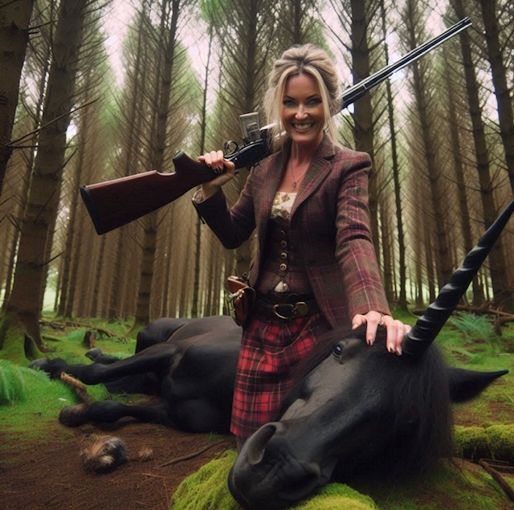
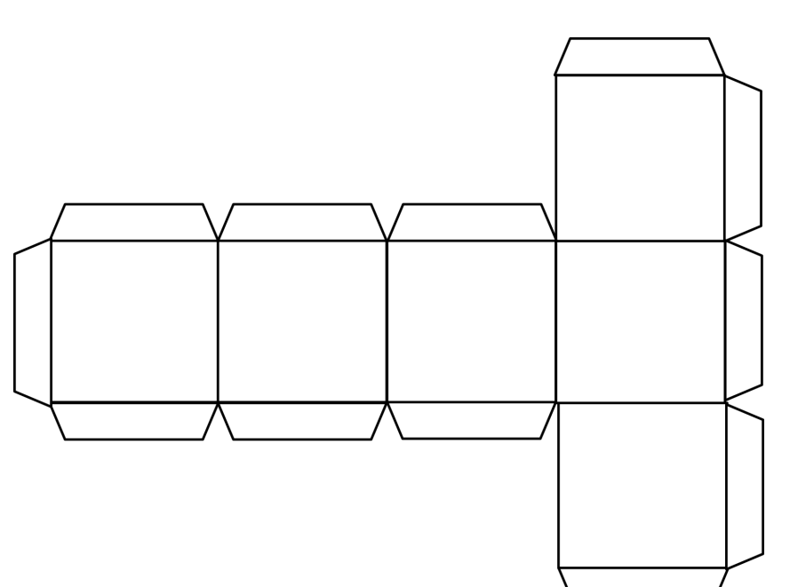
Week 4
Summary
L.I – Pick out the main events of the chapter and put them in my own words.
Re-read Ch 10.
Create a story cube as a summary of the main events of this chapter.
Visualiser
L.I. – Picture a character/setting in my mind and use a diagram to discuss them.
Read Ch 11.
Create a character visualiser of Ailsa McAllister. Include physical descriptions and personality clues.
Read aloud skills
L.I – Read with suitable expression and fluency.
Read Ch 12
With a partner, take turns to read these chapters aloud. You could read a page each.
Mark your
partner's
reading
using the
peer assess-
ment sheet.

Slide 6
Week 5
Prior Knowledge
L.I. - Make predictions based on what I already know.
Re-read Ch 12.
Write a paragraph of your prediction about what you think will happen next in chapter 13.
(A paragraph should have 3 or more sentences!)
Metalinguistics
L.I. – Work out the meaning of tricky words in context.
Read Ch 13.
What do these tricky words mean?
crudely p94
bravado p96
brandishing p96
Write your own new sentences for these words.
Visualiser
Read Ch 14.
L.I. - Picture a character/setting in my mind and use a diagram to discuss them.
What language used by the author effectively describes the appearance, behaviour and feelings of the unicorns in the stockade?
Draw an image of them and include your quotes as evidence.
Remember page numbers.

Slide 7
Week 6
Prior Knowledge
Comprehension questions
L.I – Answer literal and inferential questions based on what I have read.
Read Chs 15&16
1.What do you think Rhona means when she says, "I'm no 'Cinder-ruddy-ella?"
2.Find a simile and metaphor used by the author in ch15. Which do you think is more effective and why?
3.Why do you think Derek went to fetch Mr Deacon?
4.Why do you think Derek is 'shuffling anxiously from foot to foot'?
Theme
L.I. – Decide on the main theme(s) of the novel using stated and implied evidence.
Read Chs 17&18
What do you think are the main themes of the novel as a whole?
Why do you think these are the main themes?
Justify your ideas with evidence from the text. ✔
Write down a quote from chapter 17 or 18 that fits each of the following themes:
FRIENDSHIP
COURAGE
ACCEPTANCE
GOOD vs EVIL
Read to Write
L.I. - Use what I have read to inspire my own writing.
Read Chs 19&20
"I'll be Ninja Girl, the midnight warrior. You can be my loyal sidekick."
"Um, no, I'm sick of being the sidekick. I'll be Wolf Boy, rescuer of unicorns in distress."
Create your own superhero alter ego. Draw a mind map, noting your superHero's powers, appearance, costume, name. What's their back story? Who is your arch enemy and why?

Slide 8
Week 7
Read aloud skills
L.I – Read with suitable expression and fluency.
Read Chs 21&22
With a partner, take turns to read these chapters aloud. You could read a page each.
Mark your
partner's
reading
using the
peer assess-
ment sheet.
Writer's Craft
L.I. – Identify aspects of writer's craft and discuss the effectiveness.
Read Chs 23-26
Re-read the part where Lewis and Sneachda are being chased by Ailsa in her landrover.
What effective language does the author use to help the reader visualise this scene?
(verbs, adjectives, phrases)
Write these down and explain why they are effective.
Book Review
L.I. – Explain my preferences for particular texts and authors and justify my opinions.
Read the final chapters.
Complete the book review template, filling in the sections as you go.
Remember to give the book a rating out of 5 stars and justify your rating.

